Slide 1
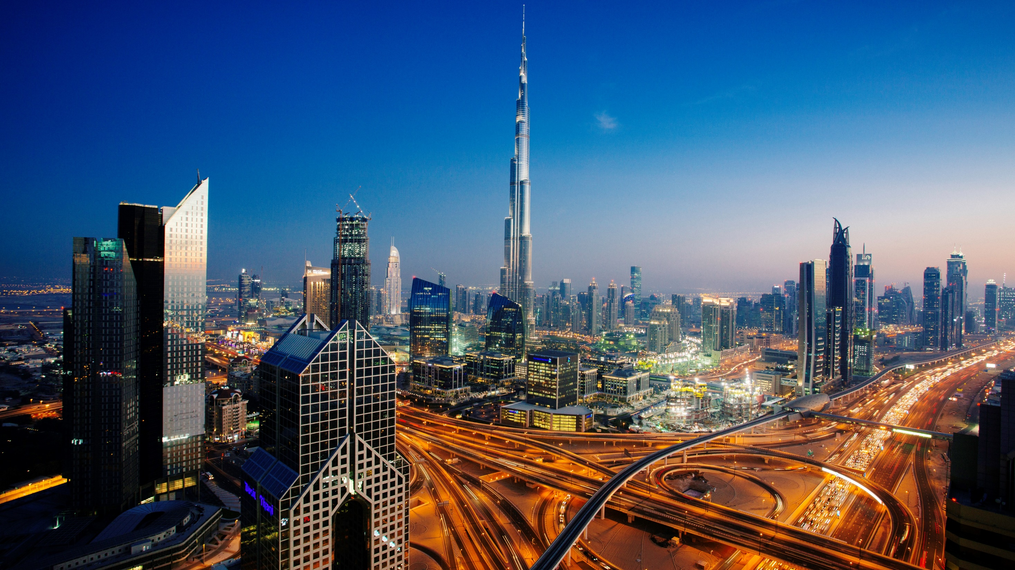

Amadeus Business Overview
Confidential
Guillaume Le Grand
glegrand@amadeus.com
Research engineer – Senior architect
Search, Shopping and Pricing
February 2024
Amadeus and Big Data
RESTRICTED
Air Price Benchmark use case

Slide 2
Agenda (10 hours)
Friday 16/02 – 8h15 to 11h45
08h15 – 09h45 Presentation of the case study (context, expected deliverables)
09h45 – 10h00 Break
10h00 – 11h30 Teamwork (6 teams of ~7 students) + Q&A (each group prepares a teams room and invite glegrand@amadeus.com and guillaume.legrand@centralesupelec.fr)
Friday 15/03 – 13h30 to 16h45
Teamwork + checkpoint and Q&A
(Book a 30’ Teams meeting with me - glegrand@amadeus.com and guillaume.legrand@centralesupelec.fr)
13h30, 14h, 14h30, 15h, 15h30, 16h.
Friday 12/04 – 13h30 to 16h45
13h30 – 16h00 “Soutenance” (10’ presentation, 5’ demo, + few questions)
16h00 – 16h45 Presentation of an Amadeus implementation, Q&A, closure.

Slide 3
Agenda (9 hours)
Friday 16/02 – 8h15 to 11h45
08h15 – 09h45 Presentation of the case study (context, expected deliverables)
09h45 – 10h00 Break
10h00 – 11h30 Teamwork (6 teams of ~7 students) + Q&A (each group prepares a teams room and invite glegrand@amadeus.com and guillaume.legrand@centralesupelec.fr)
Friday 15/03 – 13h30 to 16h45
Teamwork + checkpoint and Q&A
(Book a 30’ Teams meeting with me - glegrand@amadeus.com and guillaume.legrand@centralesupelec.fr)
13h30, 14h, 14h30, 15h, 15h30, 16h.
Friday 12/04 – 13h30 to 16h45
13h30 – 16h00 “Soutenance” (10’ presentation, 5’ demo, + few questions)
16h00 – 16h45 Presentation of an Amadeus implementation, Q&A, closure.

Slide 4

A story of the travel industry
Amadeus and Big Data

Slide 5
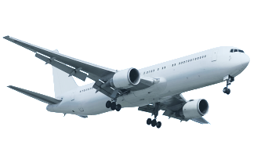








Back in the 70s…
3
_ History
The Air Travel industry before…
Travel agent
New-York
Paris
Fares are not directly related to flights
Look at flight schedules (direct or with connections)
Check fares that apply (through fares or itinerary split)
Check availability and book on each Airline Reservation System (phone)
Create the ticket
$800
$300
Bucharest
New York
Paris
$600

Slide 6
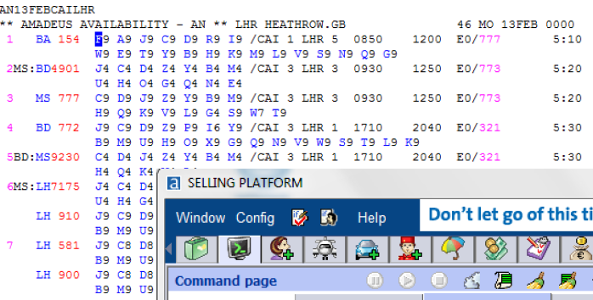
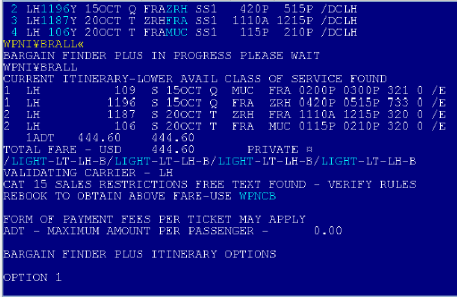
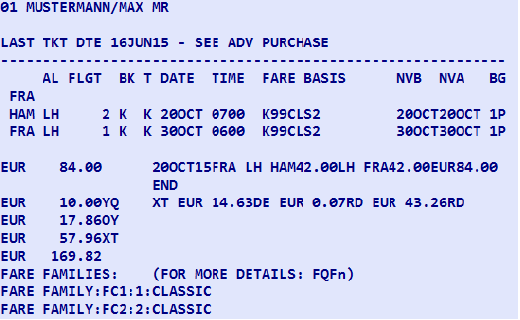
Back in the 90s…
10 years before internet
Global Distribution Systems (GDS)
IT system
B2B
Connects Travel agents to all airlines
Search: Flight schedules, Fares, Availability
Booking / Ticketing
Handles interlining
Travel agent
Airline 1
GDS E.g. Amadeus
Travel agent
Airline 2
Airline 3
Travel agent
Airline 4
Airline 5

Slide 7
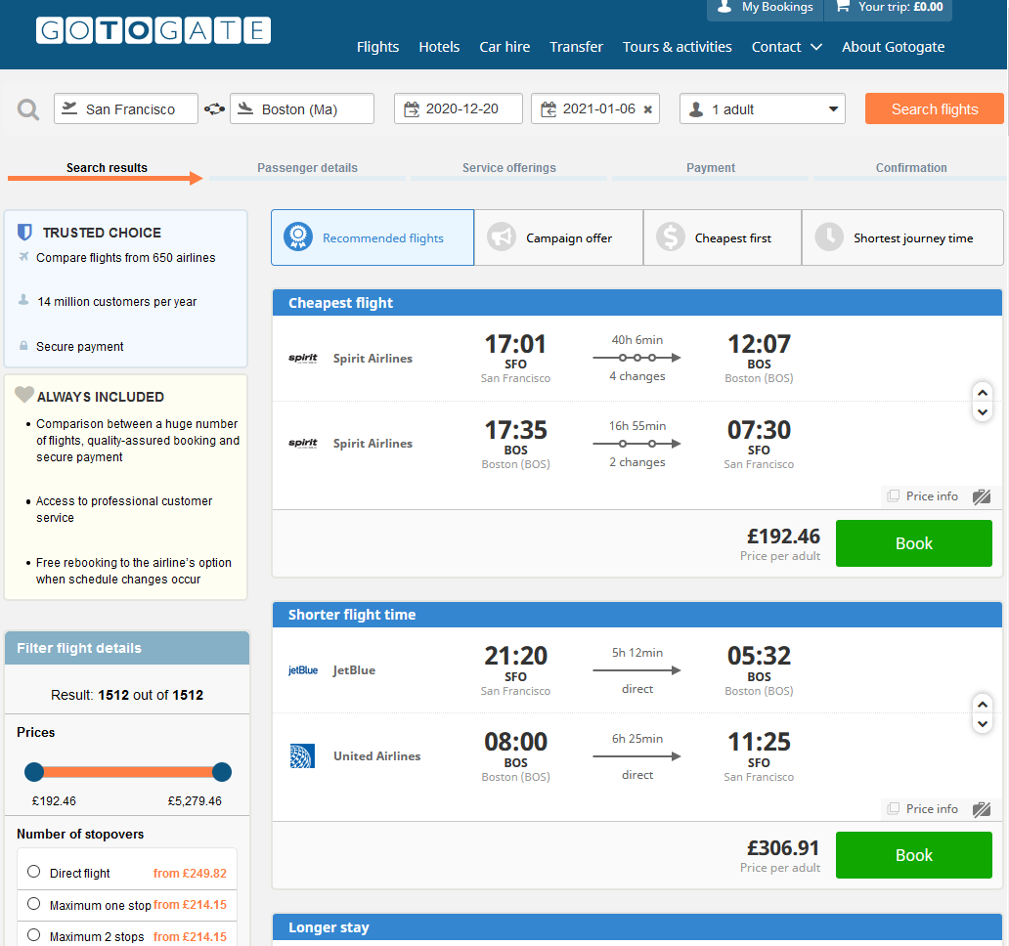


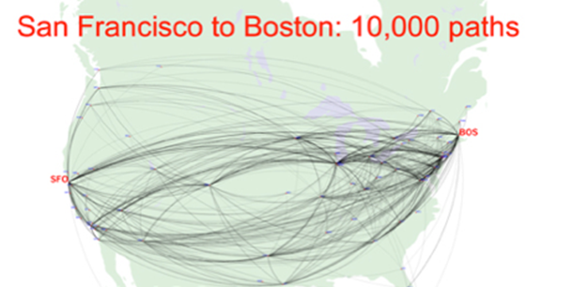
Nowadays
Online shopping
Amadeus
Flights
Airlines
SFO-BOS 20DEC–06JAN
Master Pricer verb
Avail.
Travels recommendations
Fares
Outbounds: 10,000
Inbounds: 10,000
→ 10⁸ itineraries
Fare combi: ~10⁶ per itinerary
10¹⁴ combinations
250 recommendations
OLTA: Online Travel Agency
Demo
Notes:
Shopping
For OTAs
Query: OnD-dates Returns: set of travel recos
assemblies data provided by the airlines: flights, fares and availability
Complexity
number of flights and fares
Exploring as many as possible and returning the best ones
Search domain is too big to be explored in a reasonable time
→ heurism: flight domain reduced to less than 1000 paths per bound.
MP resp time 3-4s avg (up to 12s) but MP doesn’t find the cheapest solution in 20% of the cases

Slide 8
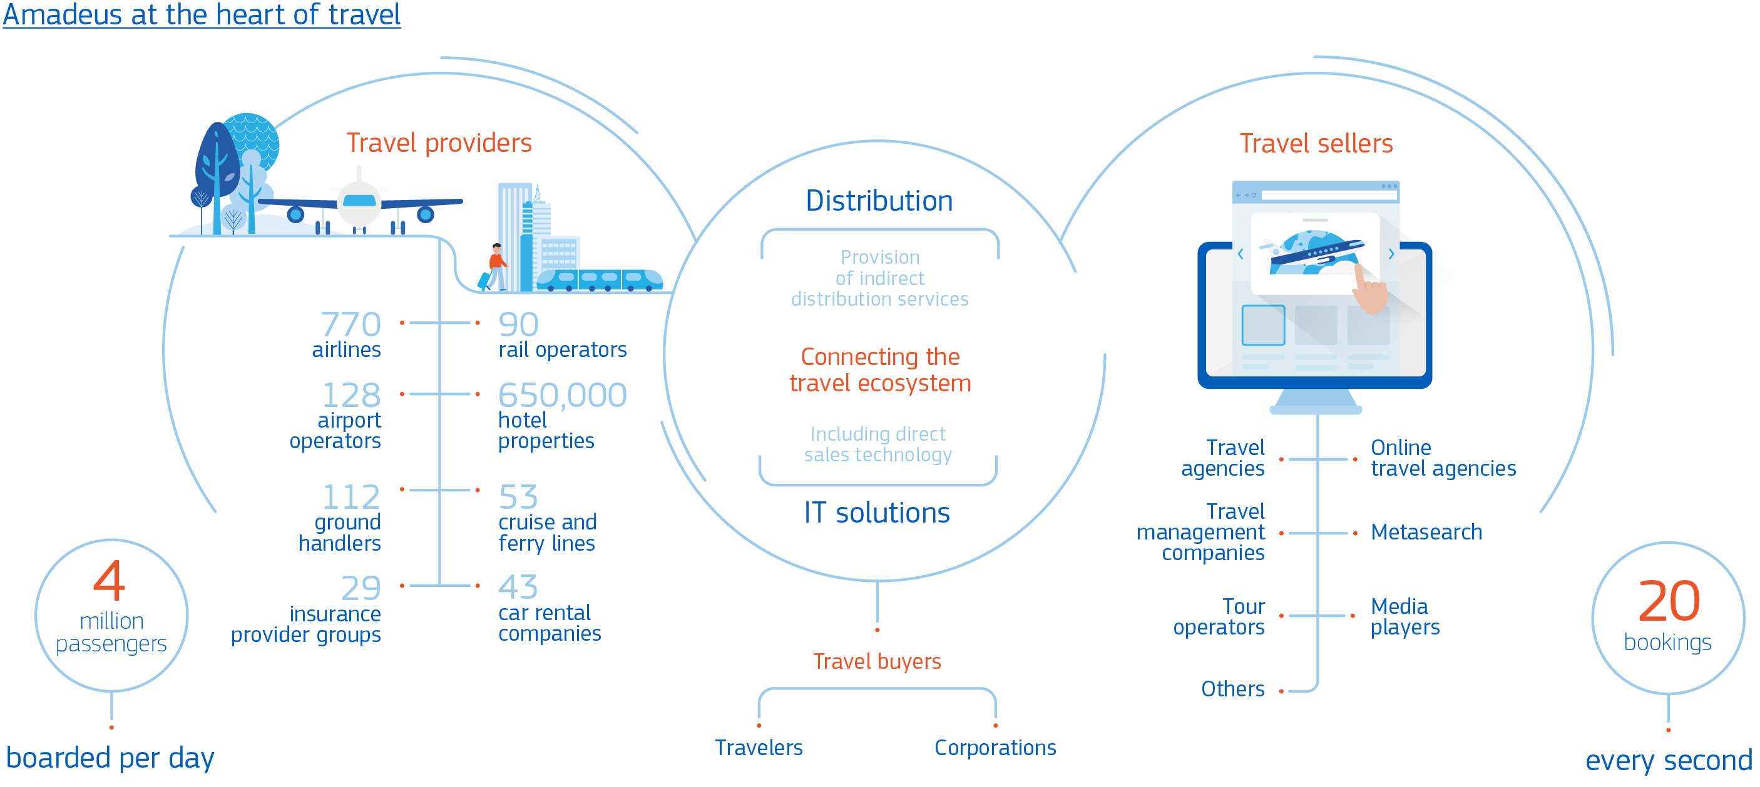
Our business model
Amadeus at the heart of travel
© Amadeus IT Group and its affiliates and subsidiaries
Notes:
DIS and IT solutions are our 2 business activities. They are at the hart of Amadeus.
We serve every part of the global travel ecosystem. Amadeus’ customers include travel agencies, both online and offline, focused on leisure travel and business travel, and corporations themselves; airlines, airports, ground handlers, hospitality businesses, railway and car rental companies, tour operators, insurance provider groups, insurance companies, ferry & cruise lines and other businesses involved in global travel.
As we’ve seen we serve every part of the global travel ecosystem and we are present at every step of the traveller’s journey

Slide 9
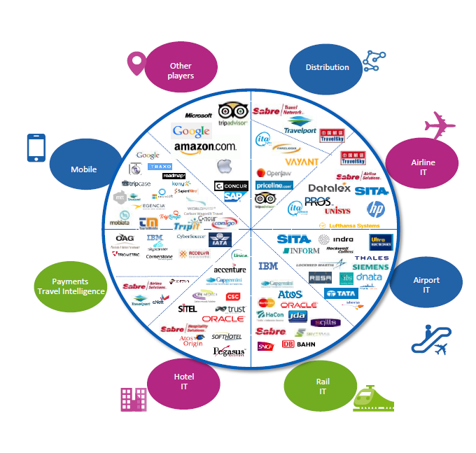
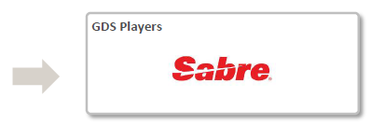
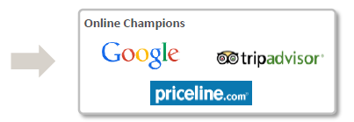
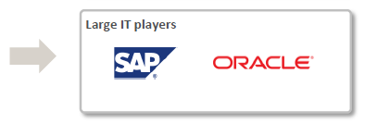
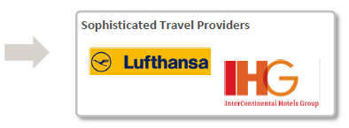
Tourism industry: IT landscape
We are in a complex and dynamic ecosystem
© Amadeus IT Group and its affiliates and subsidiaries
Notes:
Our competitive landscape has changed substantially in recent years. In the past, it was relatively straight-forward to compare against our two direct competitors: Sabre and Travelport. Over time, we were able to understand what they do and actually overcome them, becoming the leading travel technology company worldwide.
However, as we grow and diversify into different areas, the landscape has become more and more complex. A whole new range of competitors beyond the traditional GDS players is now in our scope: Travelsky, Datalex, Farelogix, PROS or Lufthansa Systems in Airline IT solutions; Sita and Rockwell Collins, amongst others, in Airport IT; Oracle and Infor in Hospitality; IBM and Silverail in Rail; eNett and Conferma in Payments, etc.
To make it even more complex, some of these new players might not only be our competitors, but also partners, suppliers, intermediaries… so it gets increasingly challenging to monitor and make sense of the activity around us.
On the one hand, we see other large IT players entering our space. We size the overall addressable market of travel technology at approximately 73 billion euros and market sources see the spend in travel tech growing at close to 4% through to 2019. This obviously makes our space very attractive for the leading IT companies worldwide.
In Corporate IT, for instance, we are facing SAP, who acquired Concur Technologies – the leader in the multi-billion dollar market for travel and expense management solutions. In Hospitality, a key part of our diversification strategy, we see Oracle as the key player with over 60% market share, following their acquisition of MICROS Systems, a software and hardware provider for the hospitality and retail industries.
Additionally, we must pay attention to other players like Google, Airbnb, Facebook… who have the resources and scale to massively disrupt our space if they choose to move into it. And companies like HP or Amazon, who, despite not being direct competitors, offer IT infrastructure, artificial intelligence, cloud services and other platforms to many of our customers.
On the other side of the spectrum, we should also look at niche companies, typically smaller or even startups, who compete in specific areas of the market. Here we see a new breed of players with strong focus on data collection to help our customers personalize their offer: Adara or Sojern in advertising, customer intelligence services like Boxever (for airlines) and Revinate (in hospitality), and recently established startups like Journera or Air Black Box.
So, as a conclusion, how do we see the future of travel? What is going to make us different?
Personalized: Tailor-made experiences unique to the traveller’s preferences
Connected: A smooth, door-to-door experience
Sustainable: Economically, socially and environmentally responsible growth

Slide 10





















































































Some Amadeus Customers
© Amadeus IT Group and its affiliates and subsidiaries
Notes:
In order of appearance: rail, travel agencies, airports, airlines, hotels
For IT:
Airlines IT (143 Airlines)
Hotel IT (4 Hotel Chains)
Rail IT (3 Railways)
For Distribution:
- 716 airlines (over 430 bookable)
- 22 Insurance companies
- 50+ cruise and ferry lines
- 239 tour operators
- 250,000+ hotel inventory
- 31 car rental companies
100 railways

Slide 11
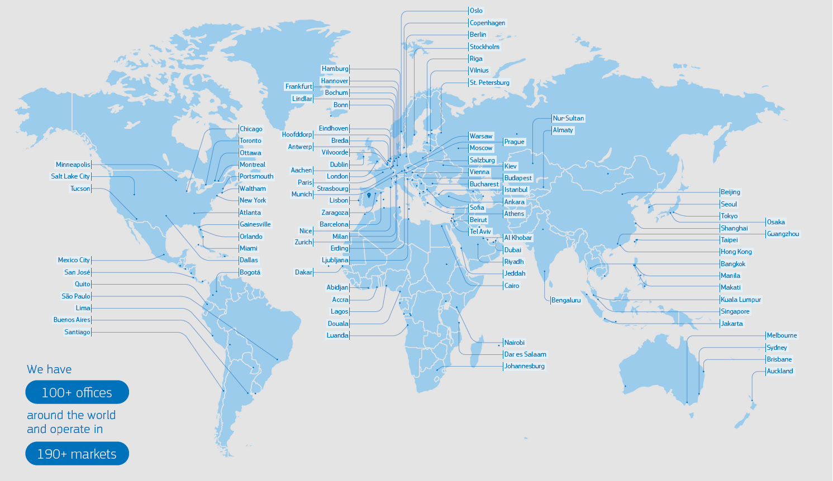
Amadeus world presence
Main R&D sites

Slide 12
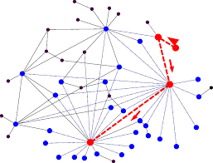
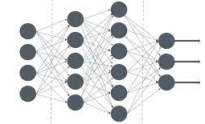
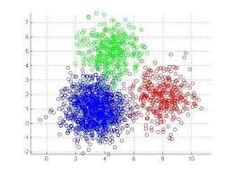
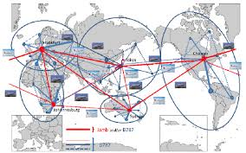
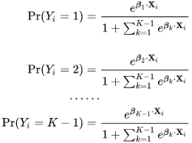
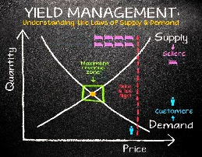
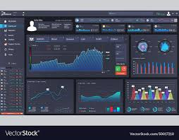
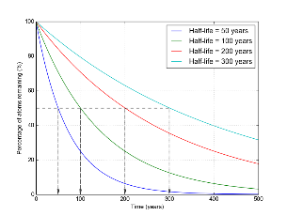
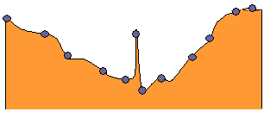
Some challenges I met
Graph search branch&bound
Finding cheapest routes
Middleware
Optimization
Big Data
Machine Learning
Cloud
Deep learning
Travelers segmentation
Selecting relevant trips
Network optimization
Multi-logit Customer Choice model
Airline Revenue Management
Predict demand vs price
Distributed in memory cache
Caching
Real time KPIs
Monitor 10k tx/s
Cache Management
Detect unexpected pattern

Slide 13
Internship opportunities
Generic internship proposals: opportunities.jobs.amadeus.com
Some internship topics:
Cloud Optimization through AI
IT debt management
Enhanced payment monitoring through probabilistic modelling
…

Slide 14

Amadeus and Big Data
Air Price Benchmark use case presentation
© Amadeus IT Group and its affiliates and subsidiaries

Slide 15
Some data we have
Amadeus
query
Flights
How it started
10,000 tx/s
Master Pricer verb
Avail.
Travels recommendations
Fares
Query
Travels recommendations
NCE-NYC Dep 05JAN 1ADT
NCE-LGA AF ECO Dep 05JAN 14:55 AF321+AF555 $600
NCE-LGA AA ECO Dep 05JAN 14:55 AF321+AA888 $650
Dep date
NCE-JFK AA ECO Dep 05JAN 14:55 AF321+AA899 $600
OnD
(Origin-Destination)
Passengers
NCE-JFK AF ECO Dep 05JAN 09:05 AF320+AF444+DL111 $700
NCE-JFK DL ECO Dep 05JAN 11:23 AF123+DL333 $900
NCE-JFK IB ECO Dep 05JAN 11:23 IB332+IB985 $950
Dep & arrival airports
…
Cabin
price
Itinerary
Main airline
10k tx/s x 60 recos → Terabytes/day
Opportunity for Business intelligence for Airline customers
Notes:
To update the text, just click on the text
More slides with this layout: Copy slide and paste

Slide 16
Data presentation
Search
Search id
Search country
Search date
Search time
Origin city
Destination city
Departure date
Return date
Passengers
Currency
Logical view
A search query
Returns:
Travel recommendations (up to 60)
Consisting in:
Flights (up to 8)
1
*
Recommendation
price taxes
fees
1
1..8
Departure airport
Departure date
Departure time
Arrival airport
Arrival date
Arrival Time
Operating airline
Marketing airline
Flight number
cabin
Flight
Departure date E.g. 15JUN22
Return date E.g. 22JUN22
Search date E.g. 15JAN22
Advance purchase: 156 days
Stay duration: 7 days

Slide 17
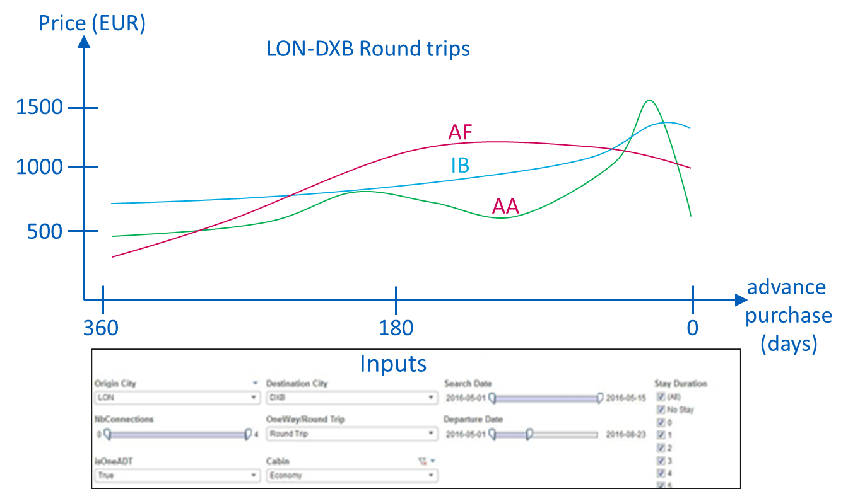
What we want to do with those data
As an airline, I would like to compare my prices with other airlines’
Interactive dashboard
Graph: Price evolution over advance purchase per airline
Mandatory inputs:
OnD (Origin-Destination city pair)
One Way / Round Trip
Many optional filters:
Search country
Search date range
Departure date range
Stay durations
Nb of connections
Passengers: 1ADT only

Slide 19
Raw data layout
Search id
Search fields (repeated)
Reco fields
Flight 1
Flight 2
Flight 3
CSV, separator: ^
One line = one travel recommendation
Search fields repeated every line for all recos of the same search
Search ID identifies a search uniquely
Recos for the same search come together
Up to 8 flights per reco
Description, examples → github.com/legubelim/travel-data-reader
Data sample → OneDrive

Slide 20
Processing
Necessary decorations to be added
Advance purchase: number of days between search and departure date
Stay duration: number of days between departure and return date
Price in EUR: price converted from the original currency (rates from ECB)
Main airline: airline that covers most of the trip
Search
Search id
Search country
Search date
Search time
Origin city
Destination city
Departure date
Return date
Passengers
Currency
Departure date E.g. 15JUN22
Return date E.g. 22JUN22
Search date E.g. 15JAN22
1
*
Recommendation
price taxes
fees
Advance purchase: 156 days
Stay duration: 7 days
1
1..8
Departure airport
Departure date
Departure time
Arrival airport
Arrival date
Arrival Time
Operating airline
Marketing airline
Flight number
cabin
Flight
Decoding, grouping and decoration done in Python script: github.com/legubelim/travel-data-reader

Slide 21
Metric
Reco: 15JAN: PAR-LON BA123 ; LON-BOS BA222 29JAN: BOS-LON BA221 ; LON-PAR BA124 Price: $700
Search PAR-BOS 15JAN-29JAN Searched on 01NOV 60 recos captured
AF $680
AF $700
IB $730
AF $1200
…
Query for dashboard
Inputs (mandatory):
OnD (Origin-Destination city pair)
OneWay/RoundTrip
Filters (optional):
Search country
Search date range
Departure date range
Stay durations
Nb of connections
Measure
Median of the cheapest price (in EUR)
Granularity
Per advance purchase
Per airline
IB $650
AF $730
LH $1100
AF $2000
…
AF $720
IB $730
IB $750
AF $800
…
SQL like
SELECT MEDIAN(price), airline, adv_purchase
FROM
(
SELECT MIN(price_EUR) AS price, airline, adv_purchase
FROM recos WHERE OnD = ‘NCE-BOS’ AND trip_type = ‘RT’
AND search_country IN (‘US’, ‘CA’)
AND search_date BETWEEN ‘2021-12-01’ AND ‘2021-12-31’
AND stay_duration IN (7,8,9,10,11,12,13)
AND nb_cnx IN (0, 1)
GROUP BY search_id, airline, adv_purchase
) t
GROUP BY airline, adv_purchase

Slide 22
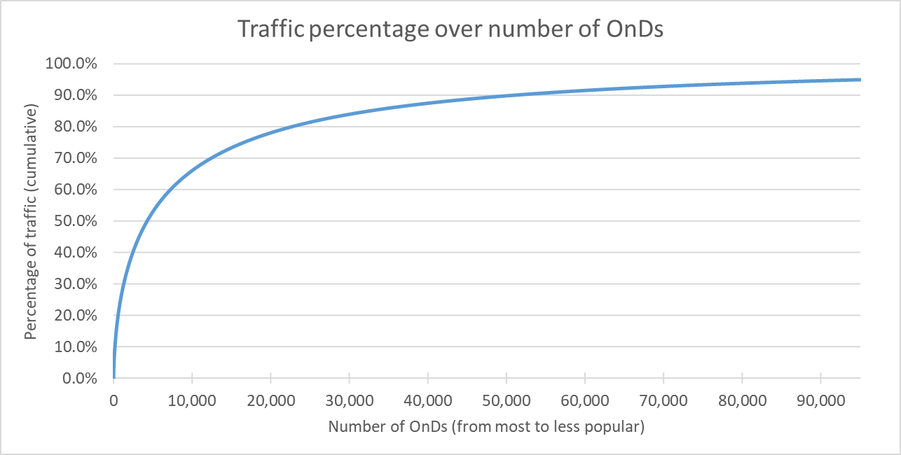
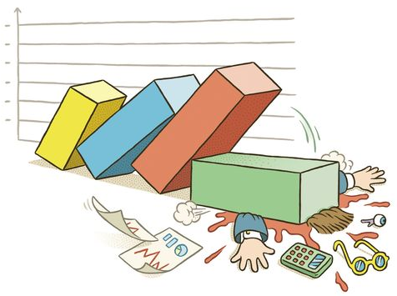
Constraints
Commercials
An airline only looks at OnDs of interest
Catalog price: $10 per OnD per year
Target is 10 airline customers
10,000 OnDs per airline, with some overlap
50,000 OnDs available in Price Benchmark
$1 mio revenue per year expected for Amadeus
Volumes
Input:
10k searches/s
60 recos / tx (captured)
→ input: 50 Bio recos/day
20Bytes per CSV record (compressed)
Storage
2 years history
Data are redundant → stratified sampling
Around 1000 searches per day per OnD are enough!
→ To store: 1000 x 50000 x 60 = 3 Bio recos/days
Latency
No need for real time
24h delay is acceptable
Pre-agregation
Latency makes it possible…
Dashboard filtering options makes it challenging
Discarded
50,000 OnDs → 90% data

Slide 23
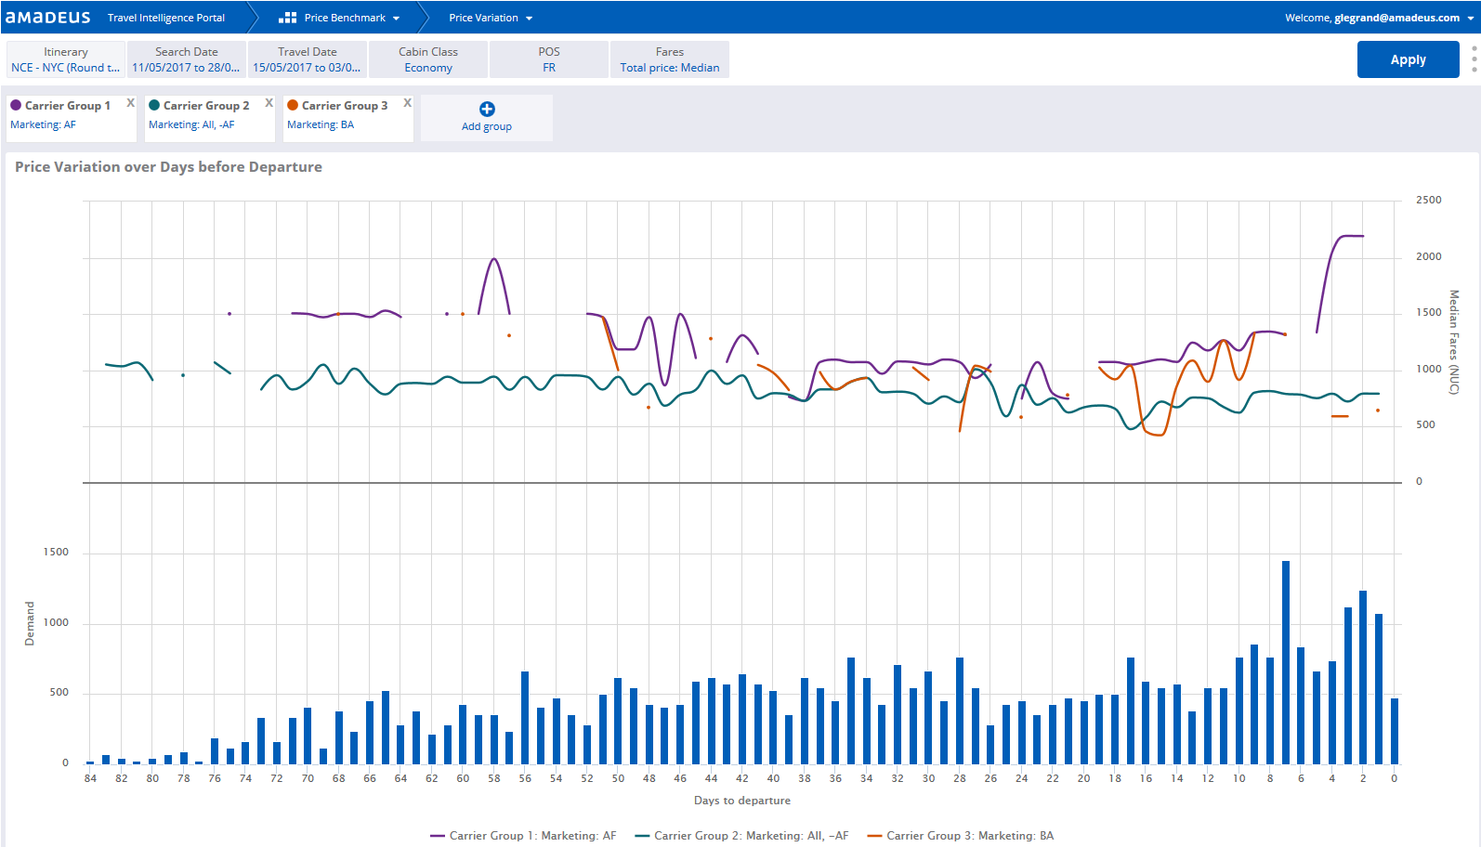
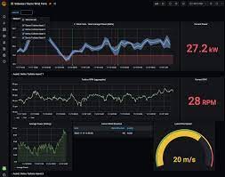

Architecture
Very high level…
Filters (OnDs, 1ADT)
Samples
Decorates
Processing
Storage
Inputs
Backend
UI
Travel recos
streamed searches (CSV)
https/internet
Currency rates
OnDs
Access rights
KPIs
Admin UI
OnD list
Monitoring
Access rights
European Central Bank

Slide 24
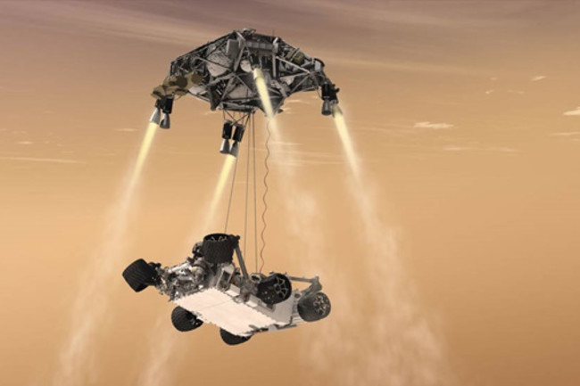
Deliverables
© Amadeus IT Group and its affiliates and subsidiaries

Slide 25
Deliverables for session 1-2 (today and 15MAR)
Just paper
Enrich architecture schema
E.g. Processing pipeline
E.g. How are rates retrieved from ECB and made available to processing
E.g. Management of OnDs and access rights
Do not necessarily select technologies at this point
Stratified sampling
How to implement stratified sampling? (I.e. around 1000 searches per OnD per day)
Monitoring
What KPIs should we monitor?

Slide 26
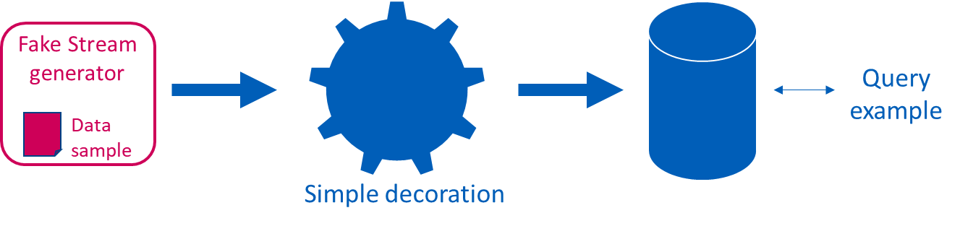
Final minimum deliverables (12APR)
More than paper
Solution description
What is the architecture?
What technologies were selected? Why? (especially data store)
How are sampling, currency conversion, monitoring […] implemented?
What can go wrong? How do you recover?
Does it scale? Give some numbers (throughputs, volumes, infrastructure size…), make assumptions if needed
What will be the cost?
Prototype: the minimum pipeline
Fake stream generator: reads data sample and push to stream
Basic processing: decoration
bare minimum with hard coded rates and no geographic data (simple logic: main airline = airline of most flights)
Load in data store
Example of query on the data store (E.g. manually from console)

Slide 27
Final bonus deliverables
Your choice
Some of those
Stratified sampling
Currency rates refresh
OnD filter
Logs management
(Some) KPIs
Automated alerting
Back-end web server
Out of scope (but not forbidden…)
Access rights management
Customer UI
Admin UI

Slide 28
Provided to you
Data sample
OneDrive
CSV format
150 MB
Few minutes traffic for origins in France
No info about customers, prices were modified
Currency rates
Daily rates from ECB (European Central Bank)
https://www.ecb.europa.eu/stats/eurofxref/eurofxref.zip
Travel data reader
github.com/legubelim/travel-data-reader
README with data description
Python script
Decodes CSV
Groups recos by search
Decorates
Advance purchase
Geography: countries, distances..
Prices into EUR
JSON output

Slide 29
Agenda (10 hours)
Friday 16/02 – 8h15 to 11h45
08h15 – 09h45 Presentation of the case study (context, expected deliverables)
09h45 – 10h00 Break
10h00 – 11h30 Teamwork (6 teams of ~7 students) + Q&A (each group prepares a teams room and invite glegrand@amadeus.com and guillaume.legrand@centralesupelec.fr)
Friday 15/03 – 13h30 to 16h45
Teamwork + checkpoint and Q&A
(Book a 30’ Teams meeting with me - glegrand@amadeus.com and guillaume.legrand@centralesupelec.fr)
13h30, 14h, 14h30, 15h, 15h30, 16h.
Friday 12/04 – 13h30 to 16h45
13h30 – 16h00 “Soutenance” (10’ presentation, 5’ demo, + few questions)
16h00 – 16h45 Presentation of an Amadeus implementation, Q&A, closure.

Slide 30
Agenda (10 hours)
Friday 16/02 – 8h15 to 11h45
08h15 – 09h45 Presentation of the case study (context, expected deliverables)
09h45 – 10h00 Break
10h00 – 11h30 Teamwork (6 teams of ~7 students) + Q&A (each group prepares a teams room and invite glegrand@amadeus.com and guillaume.legrand@centralesupelec.fr)
Friday 15/03 – 13h30 to 16h45
Teamwork + checkpoint and Q&A
(Book a 30’ Teams meeting with me - glegrand@amadeus.com and guillaume.legrand@centralesupelec.fr)
13h30, 14h, 14h30, 15h, 15h30, 16h.
Friday 12/04 – 13h30 to 16h45
13h30 – 16h00 “Soutenance” (10’ presentation, 5’ demo, + few questions)
16h00 – 16h45 Presentation of an Amadeus implementation, Q&A, closure.

Slide 31
It is time to join your group and start the study. Please create a Teams room (with the group name) and invite me (glegrand@amadeus.com and guillaume.legrand@centralesupelec.fr​)
Thank you!
© Amadeus IT Group and its affiliates and subsidiaries

Slide 32
